Slide 1
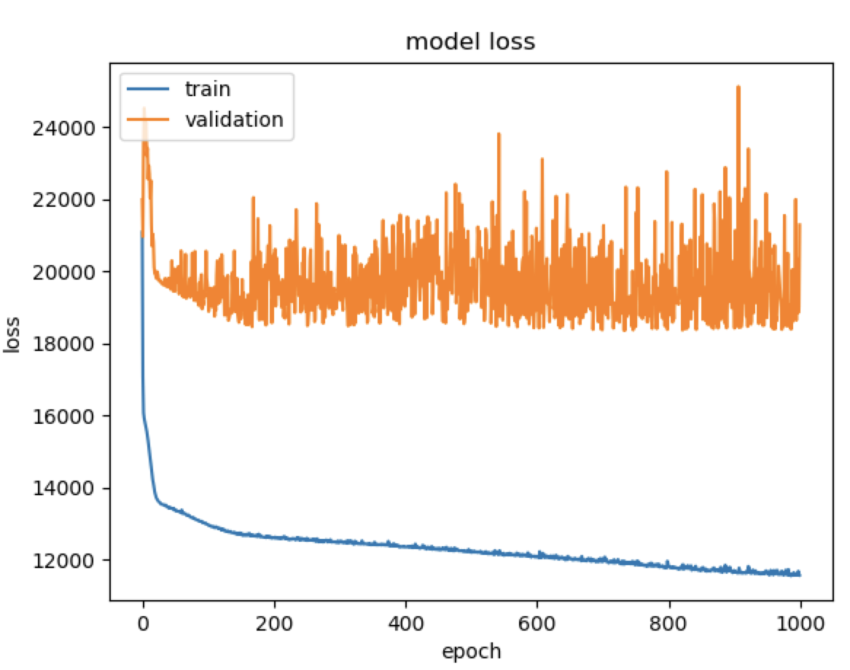
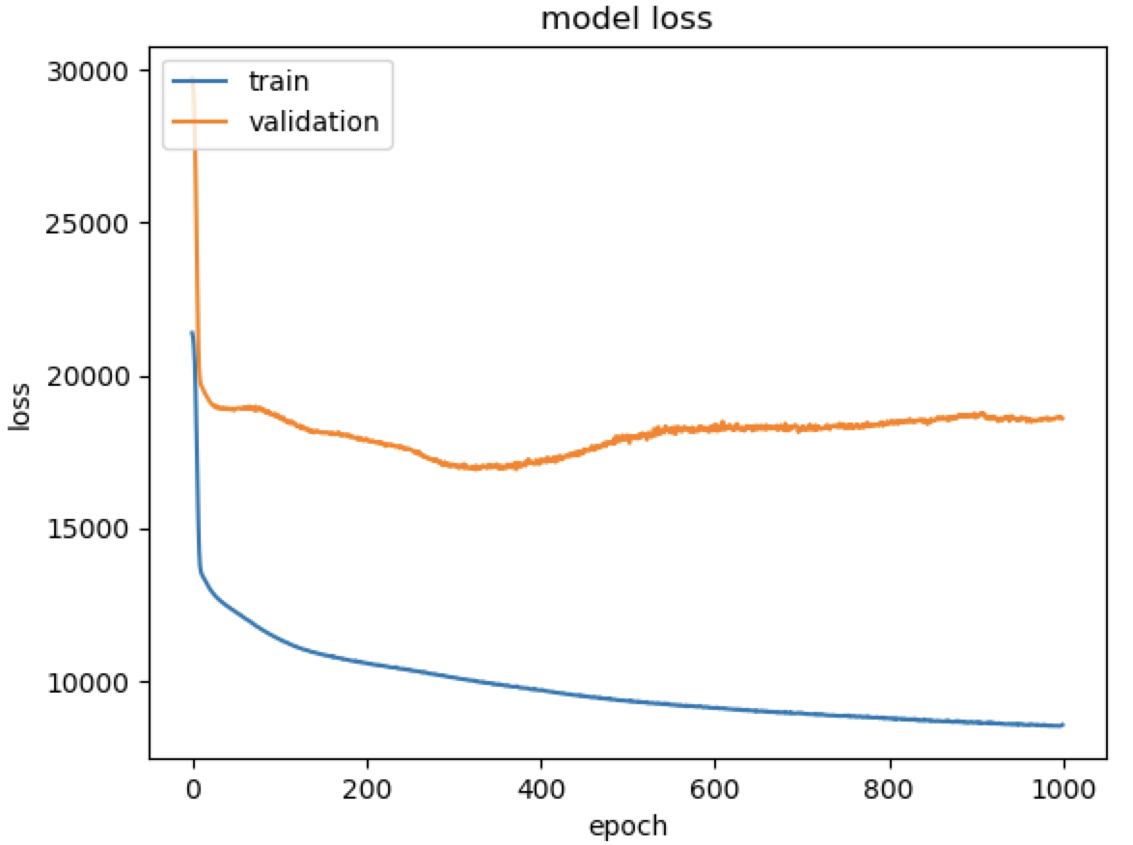
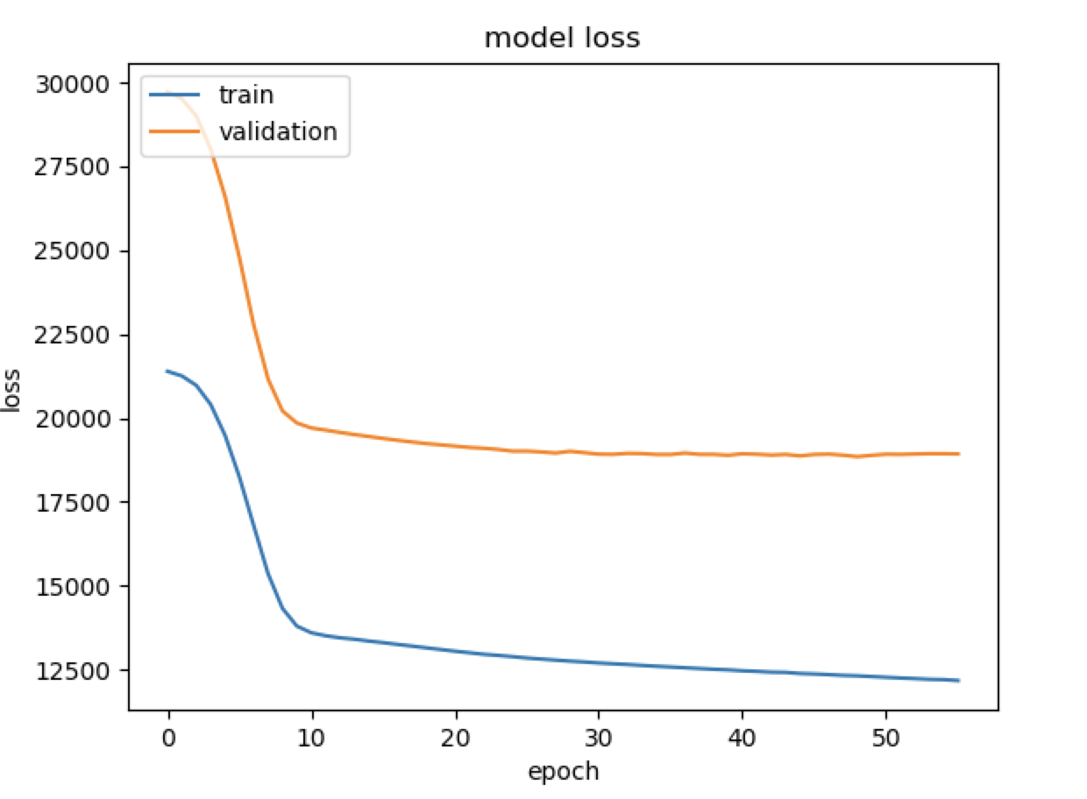

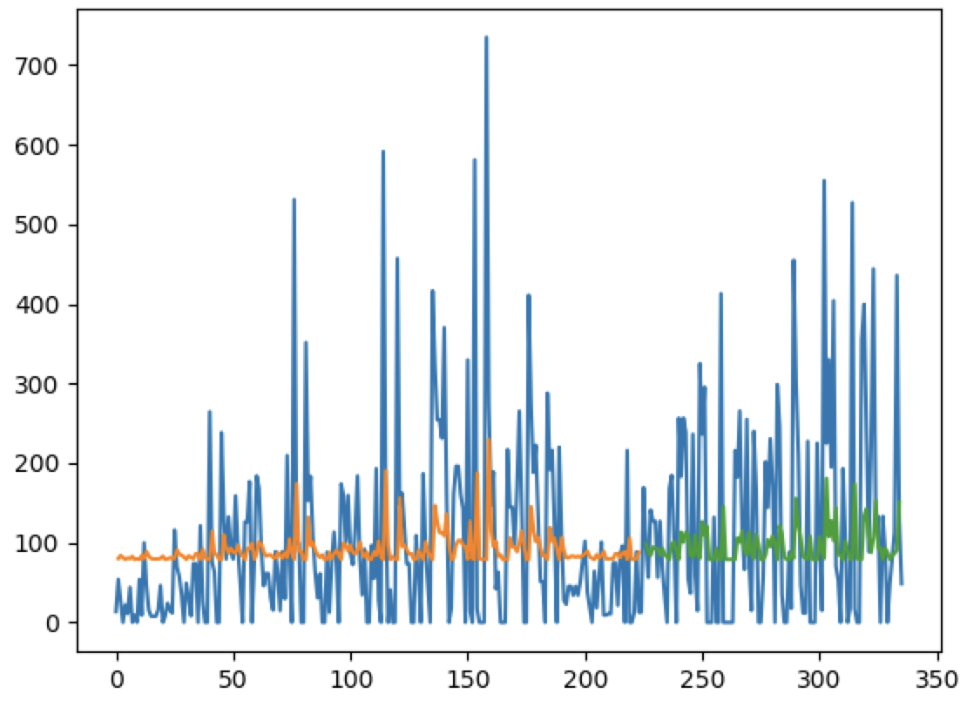
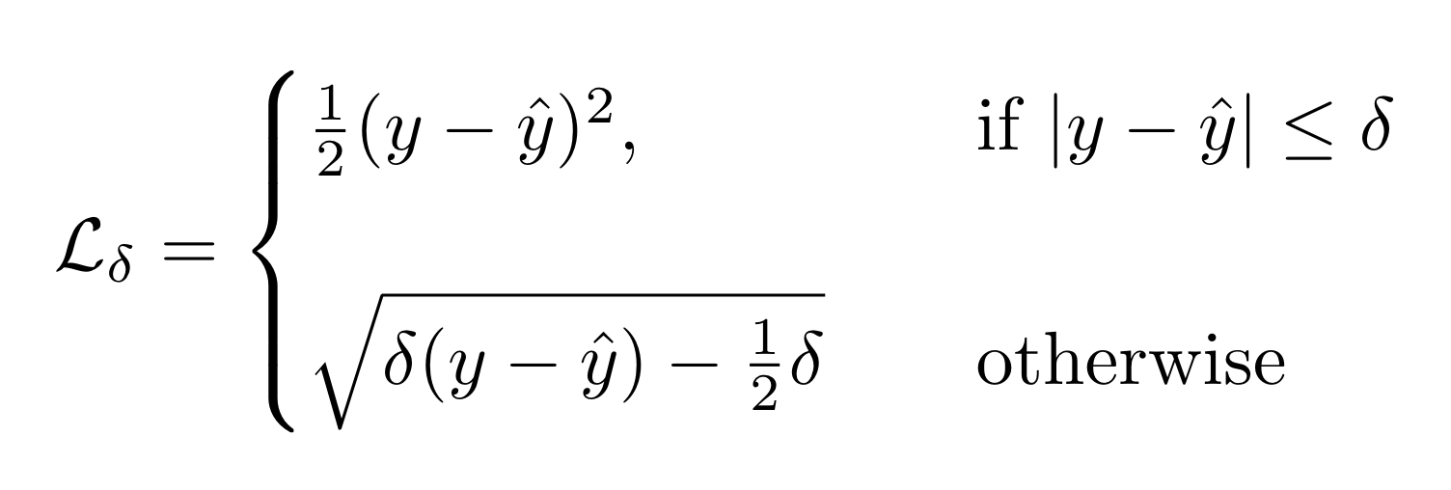
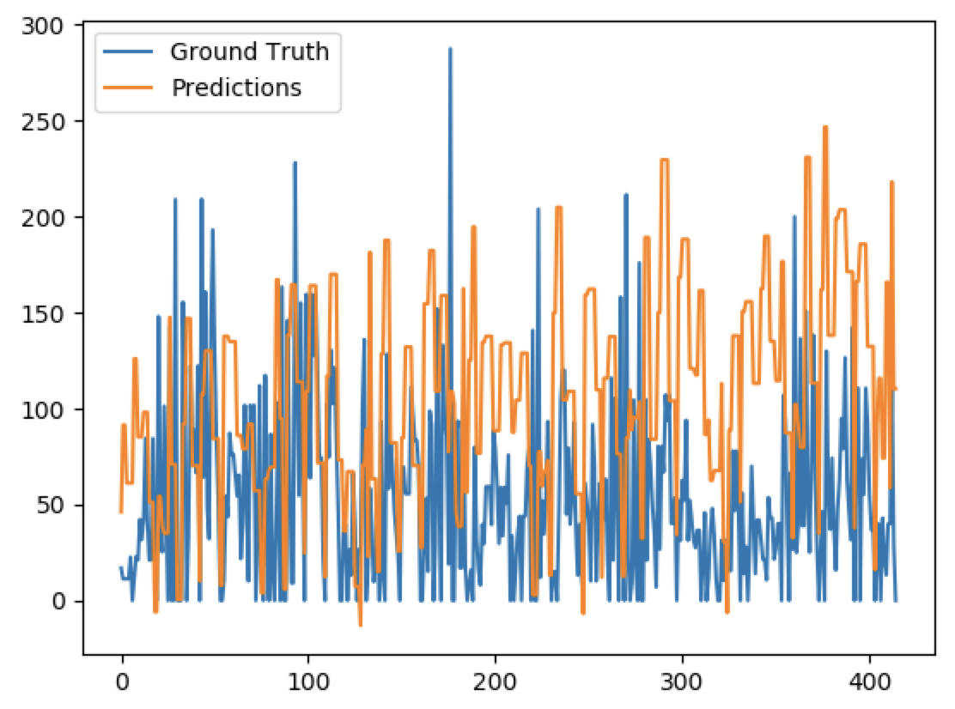
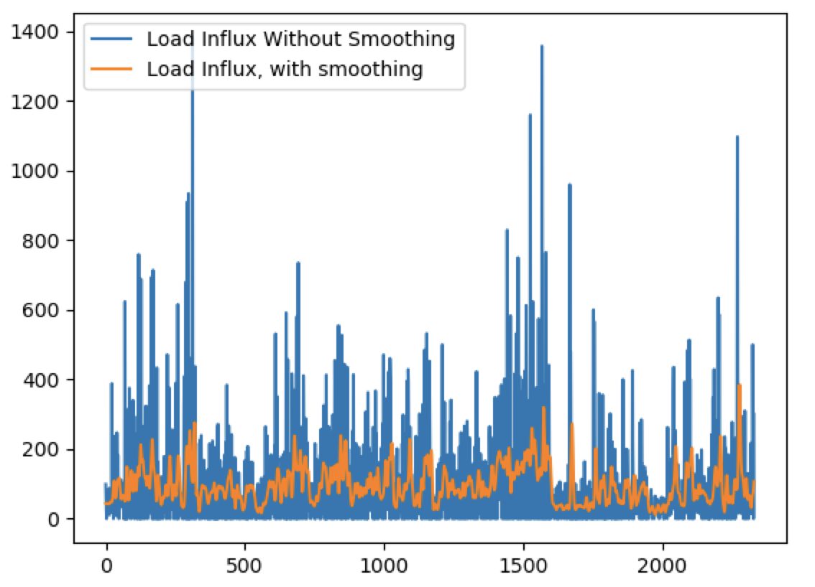
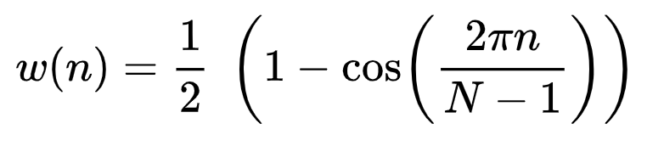
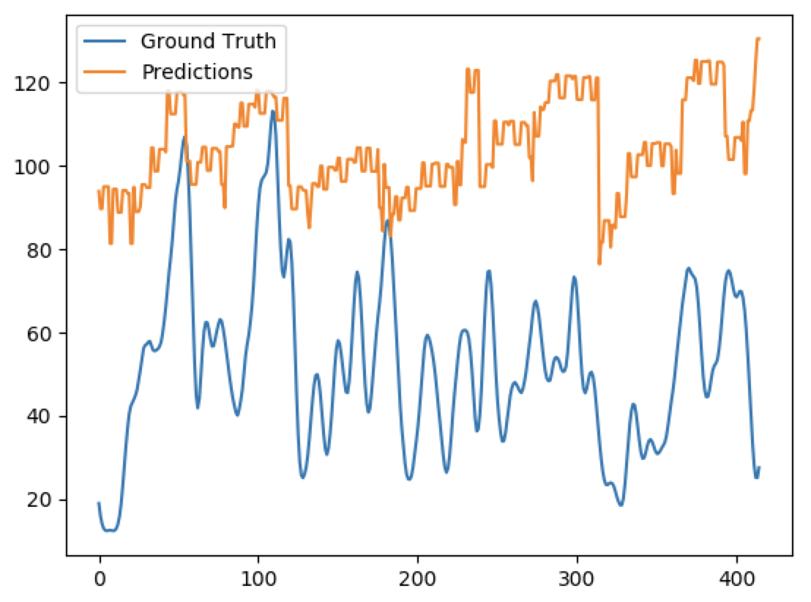
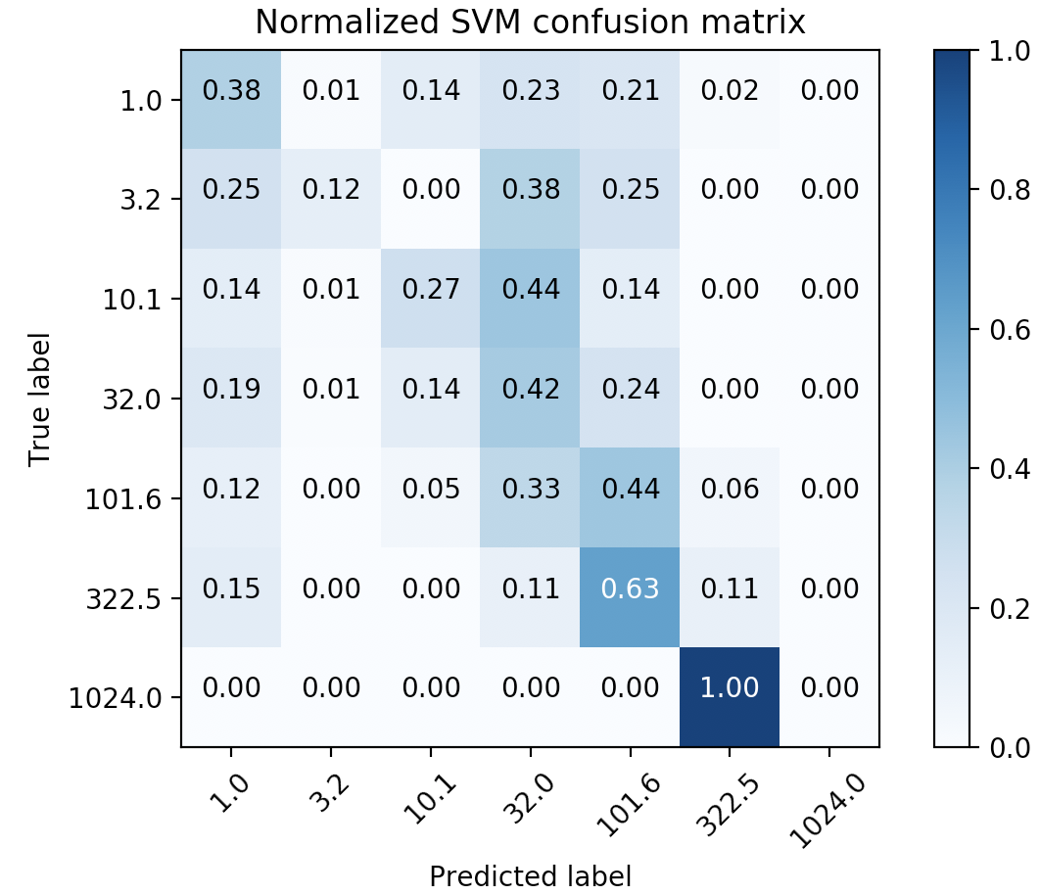

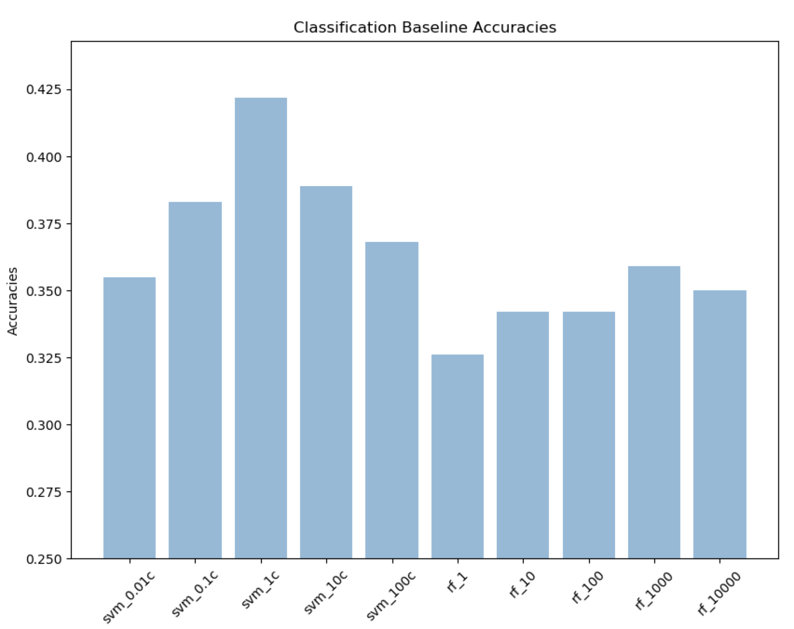
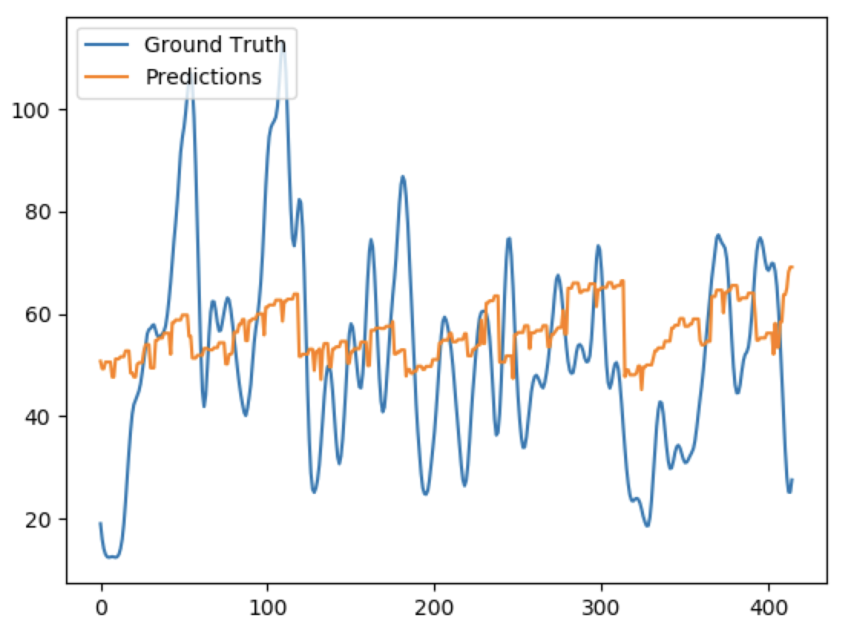
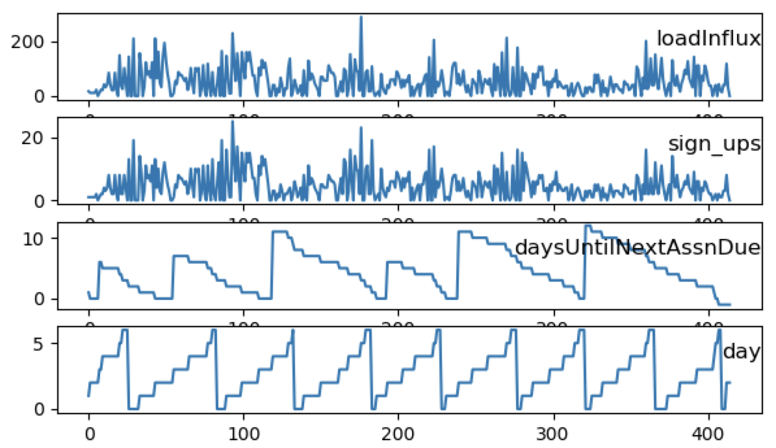
Without norm With normalization Norm + Early stopping
Deep Queue-Learning: A Quest to Optimize Office Hours
CS 229
Avoy Datta, Dian Ang Yap, Zheng Yan
Note: This project is shared between CS221 and CS229. For CS229, we focus on prediction.
CS 229
Initial mode (Univariate LSTM) predicts load influx spikes. (Blue- actual, orange – train predictions, green– validation predictions). Y-axis is the load influx, X-axis represents OH timeslots in chronological order.
Introduction
Methodology
Results
OHs often suffer from overcrowding and long wait times, stressing both students and instructors.
If we could accurately predict the expected workload at a given OH, TAs can be better allocated.
QueueStatus, Carta, and course syllabi provide a wealth of information that can be used.
We trained a neural network model that predicts student load influx (expected serve time * # sign-ups) at OH on an hourly basis, for any course.
With these predictions, we now optimize TA scheduling given realistic constraints.
We defined a new loss (Shrug loss) and used smoothing on labelled data to reduce penalty on outliers.
To reduce contributions by outliers, we also apply signal processing techniques (Hann Window smoothing).
Plot of load influx of test set against predicted
Visualization of smoothed y-labels
MSE, w/o smoothing
Experiments
MSE, with smoothing
Loss Functions | RMSE (Load Influx)
MSE | 69.89
MAE | 62.65
Huber (𝛿 = 1) | 62.61
Shrug (𝛿 = 32) | 47.03
Multiclass classification: Used log-scale buckets from 0 – 1024 mins
Class Statistics
Table 1: Statistics for sample of classes (4/8 shown)
Smoothing reduces spikes in erratic data.
Shrug loss further reduces penalty; effective in outliers and detecting spikes.
Less effective in predicting actual magnitude.
Class | Quarter & Year | #OH-Active TAs | Total # Students | Total OH Hours | Total Served | Total Load Influx
CS107 | Spring 2017 | 13 | 184 | 415 | 1722 | 21873.09
CS161 | Spring 2017 | 6 | 93 | 204 | 875 | 15380.68
CS110 | Spring 2018 | 20 | 187 | 223 | 1749 | 35459.1
CS229 | Autumn 2018 | 17 | 634 | 369 | 1390 | 31733.7
Shrug, with smoothing
SVM accuracy: 37.3% Random Forest accuracy: 35.9%
Features and Preliminary Statistics
Load influx is significantly and positively correlated with:
Week number (r = 0.07) and Number of servers (r = 0.32)
Significantly and negatively correlated with: Days left until assignment due (r= -0.08), Hour of day (r = -0.10), Weekday (r=-0.09), Days until next exam (r = -0.06)
All X-inputs are normalized between 0 and 1.
Summary
Using data scraped off of Stanford course resources, a fully connected NN, and Gibbs sampling, we have come up with a system that schedules TA hours (within realistic constraints) that appears to correlate well with student demand.
Major challenges included computational constraints, overfitting, applying real-life TA constraints, and deciding criterion of “optimality” for assignments.
Over the next week, we will extend this to more general testing data, including courses we have not seen before (ex. CS224N). We will also identify and implement metrics to estimate the efficacy of our model compared to the status quo.
.
References
[1]
[2]
[3]

